Slide 1
Species trees and genomic context

Slide 2
Genome dynamics
Speciations
Gene duplications
Gene losses
Horizontal Gene Transfers
Domain shuffling
BUT

Slide 3
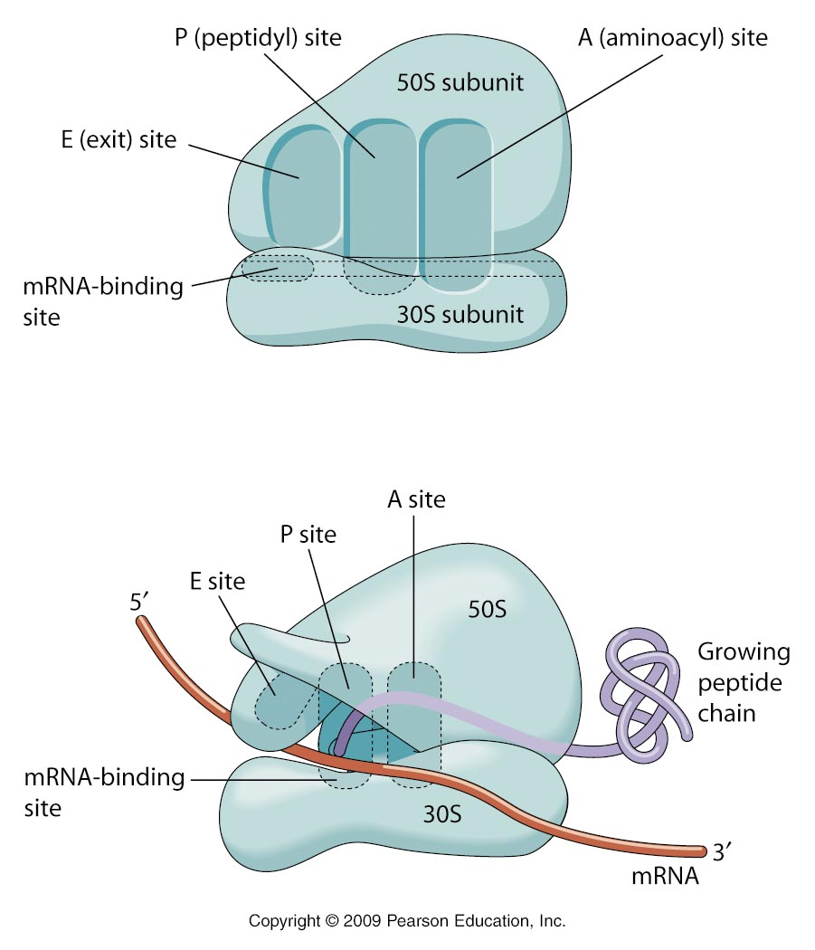
Some genes are essential and universal
The ribosome

Slide 4
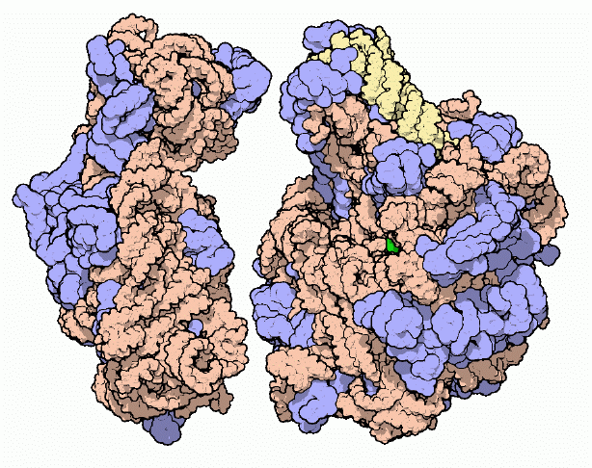
Ribosome consists mostly of RNA
16S rRNA

Slide 5
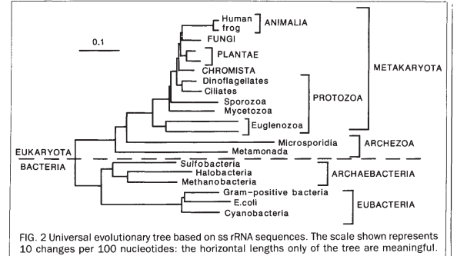
Three kingdoms based on 16S/18S rRNA
Eukaryota
Archaea
Bacteria
Cavalier-Smith Nature 1989

Slide 6
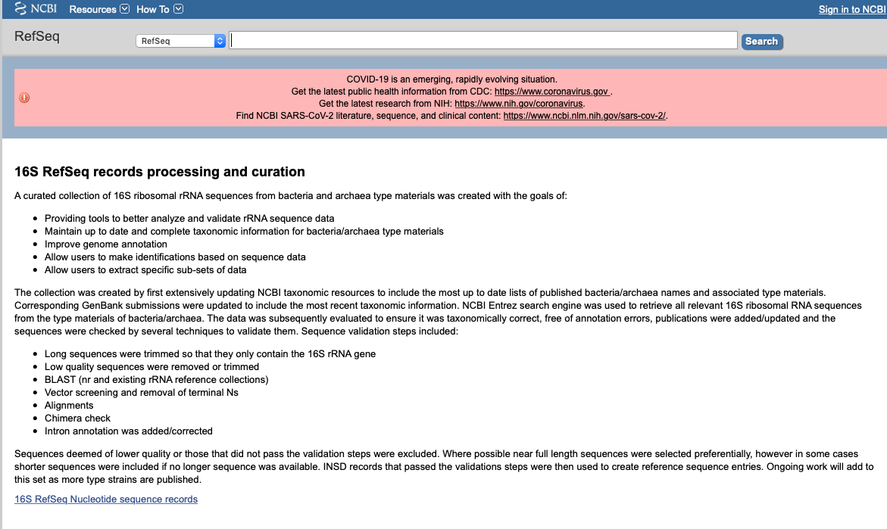
16S rRNA resources
As of 17/11/2020 21,783 records

Slide 7
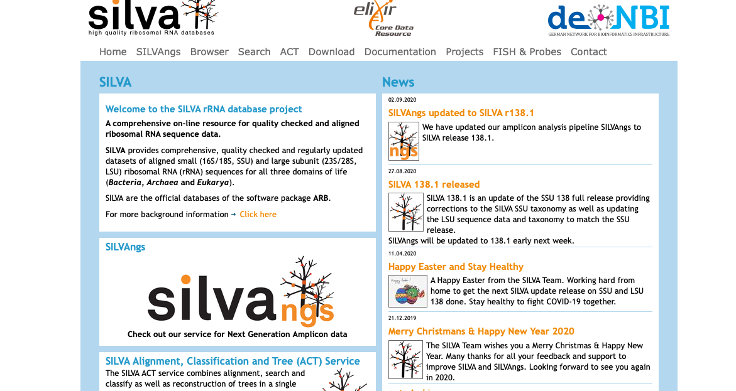
rRNA resources (16S/18S, SSU and 23S/28S LSU)
As of 17/11/2020 9,469,124 SSU records

Slide 8
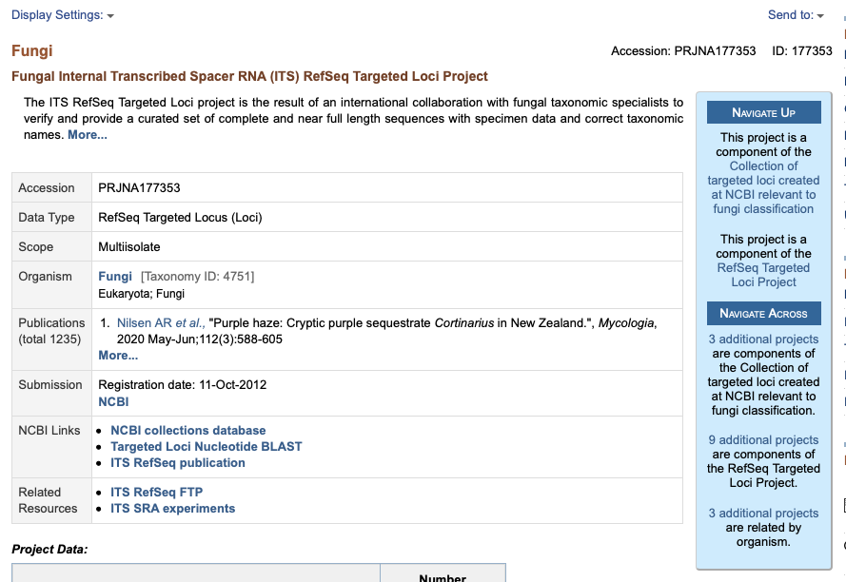
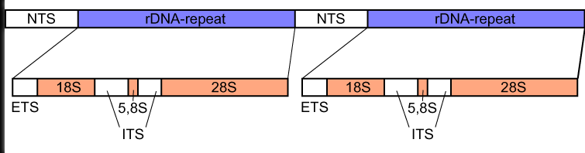
Fungal Internal Transcribed Spacer RNA (ITS) Refseq

Slide 9
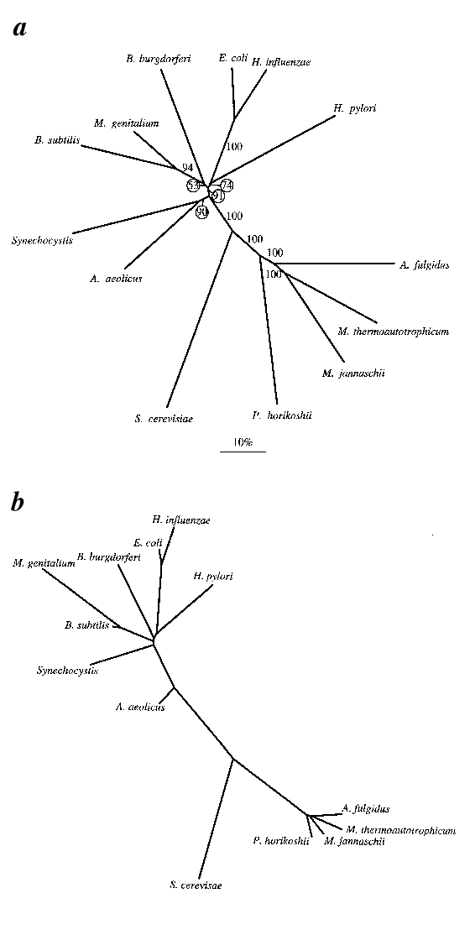
Species trees based on shared genes (BBH)
Shared genes
16S rRNA
Snel et al, Nature Genetics 1999
Notes:
the fraction of the BBH’s of the total nr of genes in the smallest genome. The distance between two genomes is then: 1-(number of shared genes/genes in smallest genome). The phylogeny is a neighbour-joining clustering of the resulting distance matrix. To obtain confidence estimates for the tree, a delete-half-jackknife²⁹ was implemented; that is, bootstrap values were calculated by selecting random subsets of 50% of the genes per genome, reanalysing the fractions of shared genes and recalculating the trees. The values represent the number of times (out of 100) a specific cluster was present. The length of the scale bar corresponds with a 10% difference in gene content.

Slide 10
Other ‘single copy’ genes based on COGs
tRNA-synthetases (8)
Ribosomal proteins (23)
Translation factor
RNA polymerase, alpha + beta subunit (2)
Preprotein translocase secY
Metal dependent protease
Ciccarelli et al, Science 2006

Slide 11
Workflow
Multiple sequence alignment for each COG for eukaryotes, archaea and bacteria (MUSCLE)
Concatenation of alignments
Removal of poorly aligned regions with Gblocks
Profile alignment of three concatenated alignments using ClustalW
Maximum Likelihood (PHYML) using JTT matrix, 2 classes of sites, gamma correction using four discrete categories.
100 bootstraps.

Slide 12
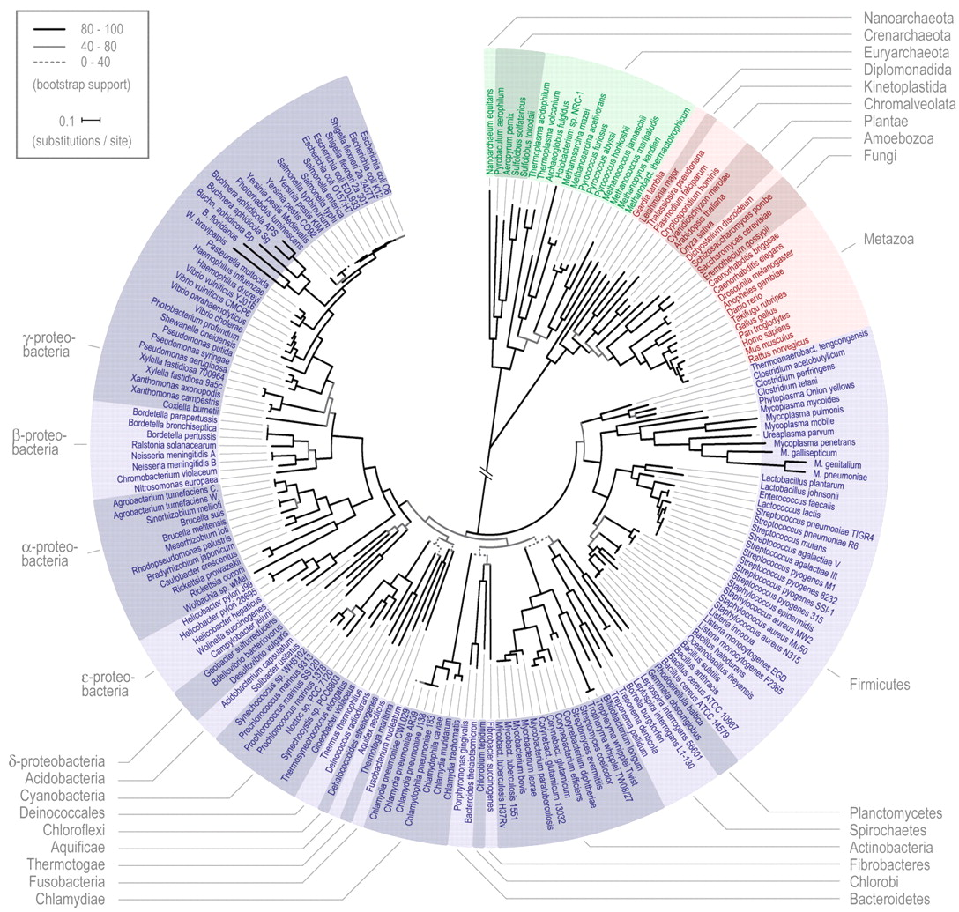
Ciccarelli et al, Science 2006

Slide 13
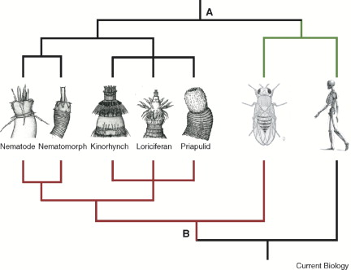
Two hypotheses of animal evolution
Supported by concatenated proteins
Coelomata
radial
bilateral
Ecdysozoa
Supported by Small Subunit RNA

Slide 14
Ciccarelli et al, Science 2006

Slide 15
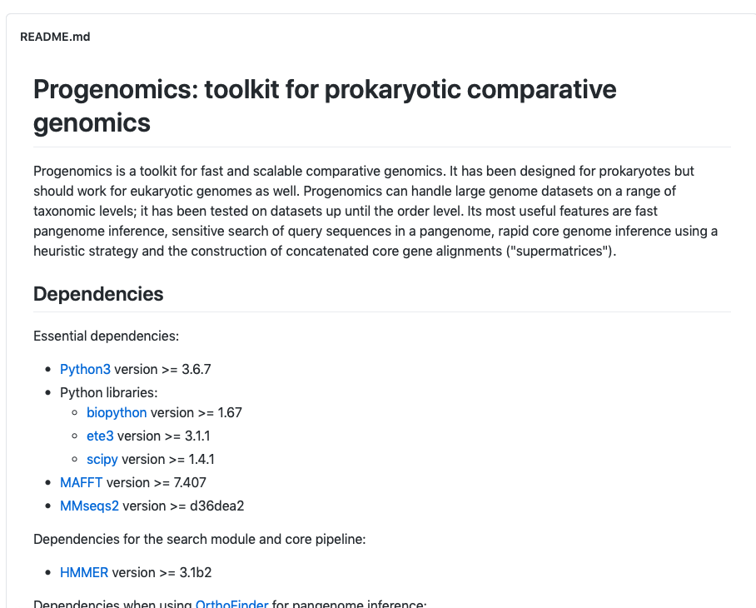
Species trees methods
16S/18S rRNA
ITS sequencing (Internally Transcribed Spacers, fungi)
Concatenated alignments of single copy core genes
Protein alignments – large distances
DNA alignments – short distances

Slide 16
Finding species
Bacteria do not reproduce sexually
Thus species concept ‘can interbreed and have viable offspring’ can not be applied
Physiological similarities +
DNA-DNA hybridization (DDH) as standard for prokaryotic species definitions (>70%)
Availability of genome sequences
Similarity in genomes

Slide 17
Species definition
Based on 16S rRNA
Pairwise nucleotide identity of the whole 16S rRNA gene > 98%
Problem: Sometimes multiple copies per genome
Based on universal single copy protein coding genes (marker genes)
pairwise identity on nucleotide level > 97%
Problem: Complete genome is needed
Problems from pairs to clusters

Slide 18
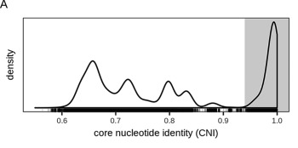
Identifying species in bacteria
Same species
Wittouck et al, mSystems 2019

Slide 19
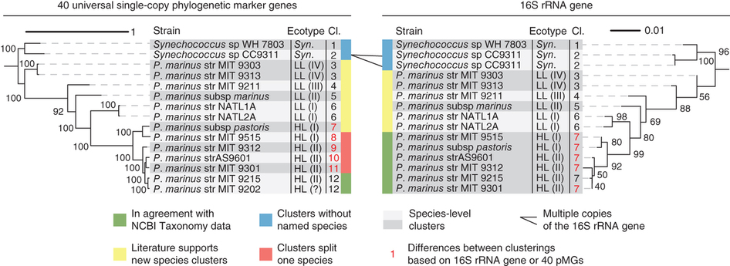
Marker genes vs 16S rRNA
Mende et al, Nature Methods 2013

Slide 20
Species trees vs species definition
Trees
Deep branches
Long distances
Concatenated protein alignments
rRNA trees
Species
Leaves
Short distances
Protein coding DNA similarity
rRNA similarity

Slide 21
Species trees
Ribosomal RNA
Concatenated alignment of single copy protein coding gens
Shared genes

Slide 22
Genomic context methods
Gene function annotation

Slide 23
Genomic context methods
Conserved gene neighborhood (synteny)
Gene fusions
Co-occurrence
Co-evolution

Slide 24
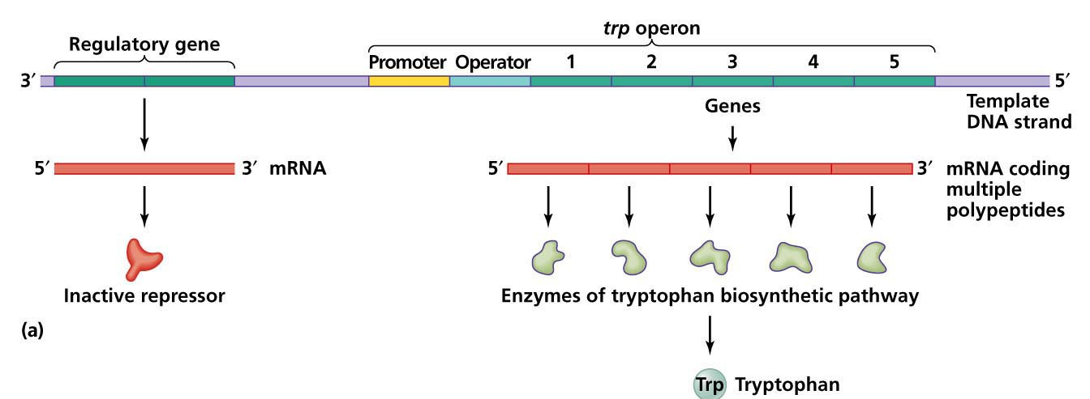
operons

Slide 25
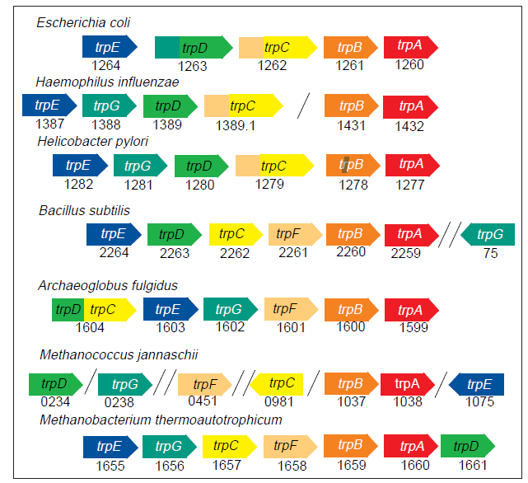
Trp operon in different organisms

Slide 26
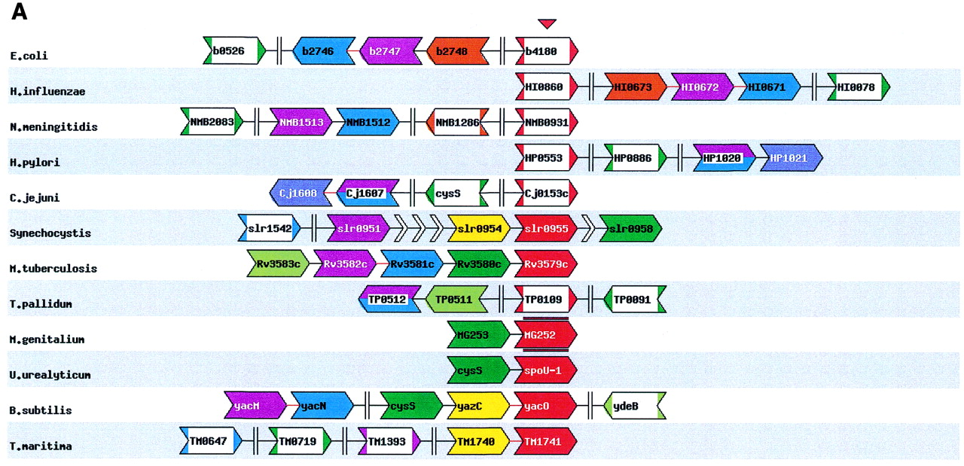
Conserved gene pairs are functionally related
Snel et al, NAR 2000

Slide 27
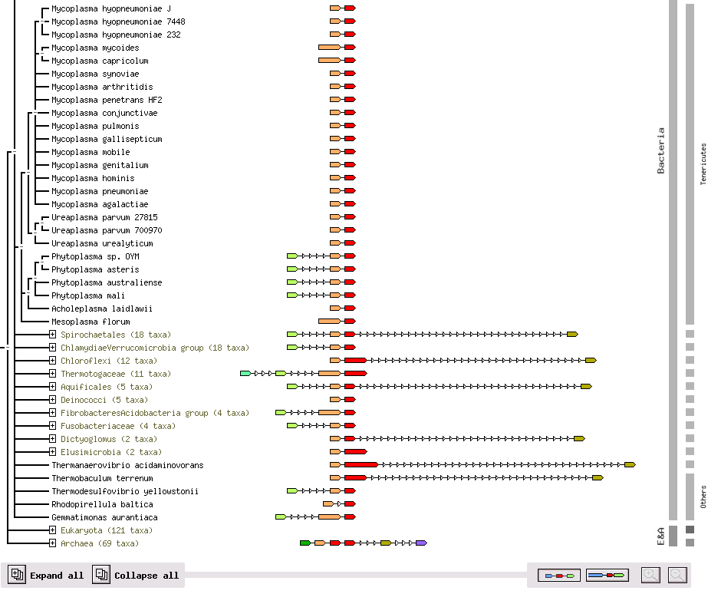
MPN515-MPN516 (RpoB-RpoC)

Slide 28
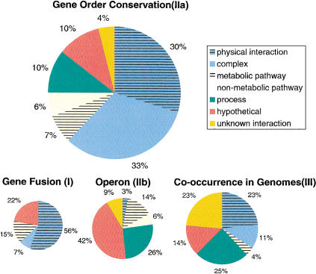
Conserved gene pairs are functionally related
Huynen et al, Genome Research 2000

Slide 29
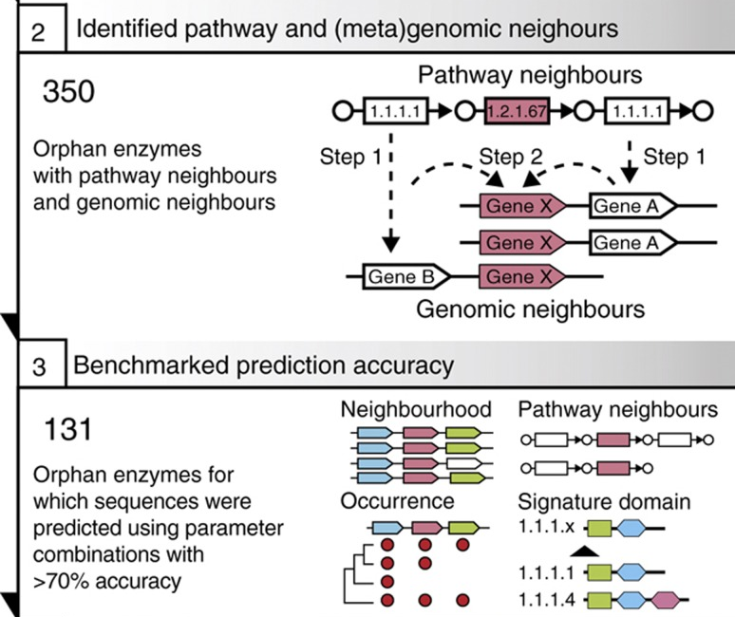
Orphan enzyme annotation
Yamada et al, MSB 2013

Slide 30
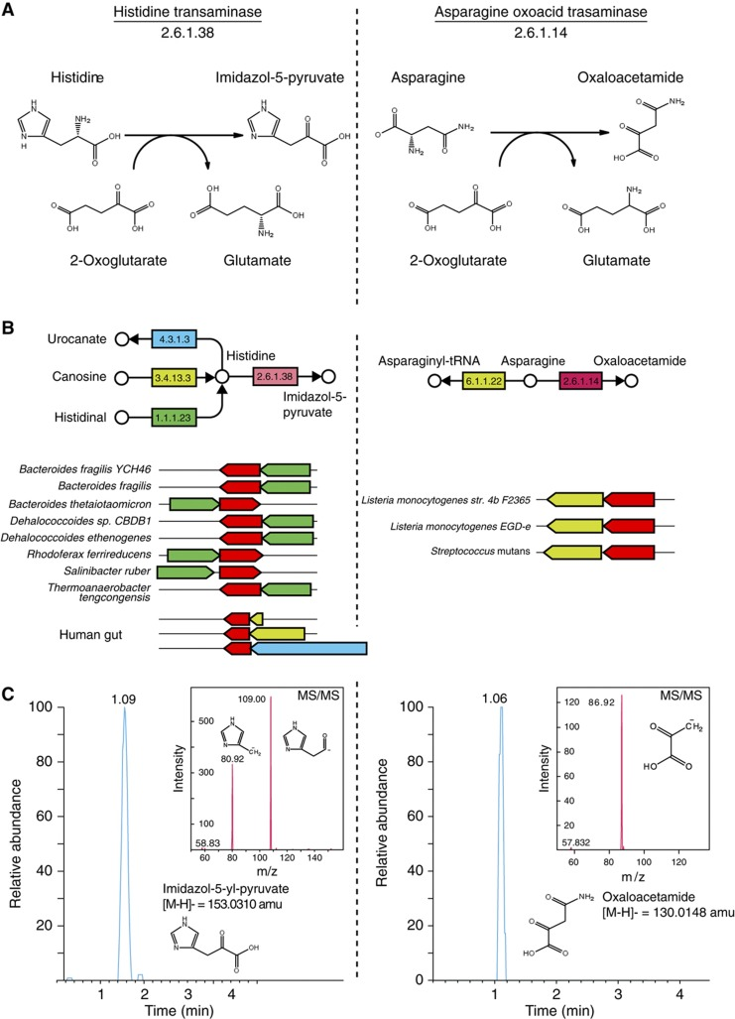
Application to function prediction
Enzymes with unassigned proteins
Yamada et al, MSB 2013

Slide 32
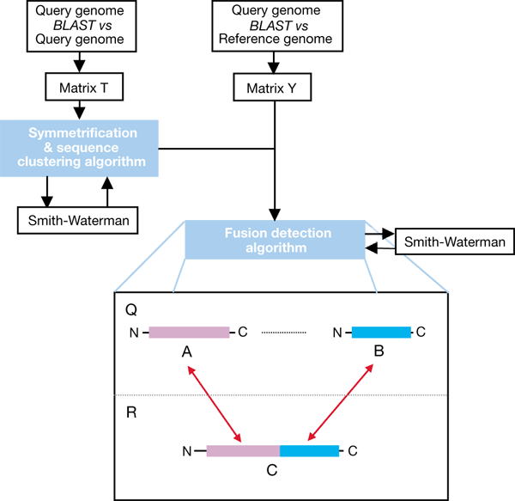
Gene fusions
Based on homologs
Enright et al Nature, 1999

Slide 33
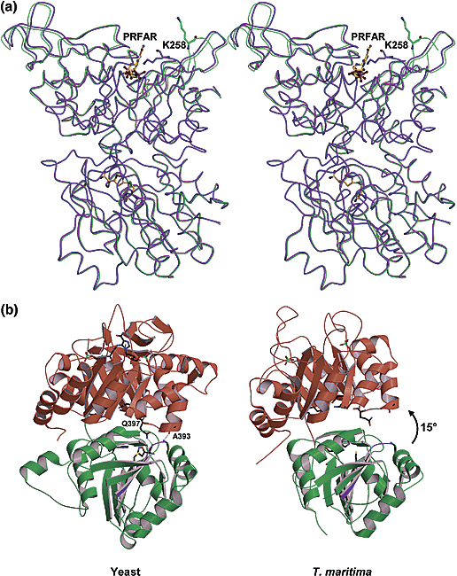
Gene fusions predict physical interactions
Bacteria
HisH
HisF
Eukaryotes
His5
Chaudhuri et al, Biochemistry 2003

Slide 34
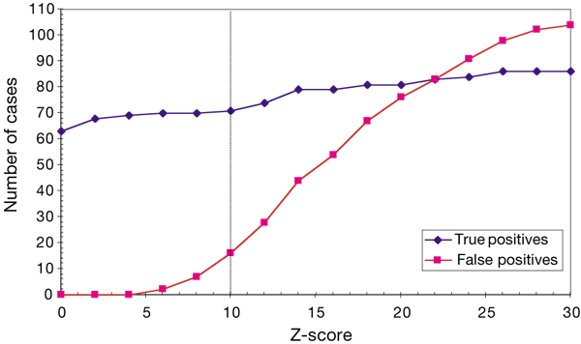
Performance for prediction of interactions
Enright et al Nature, 1999

Slide 35
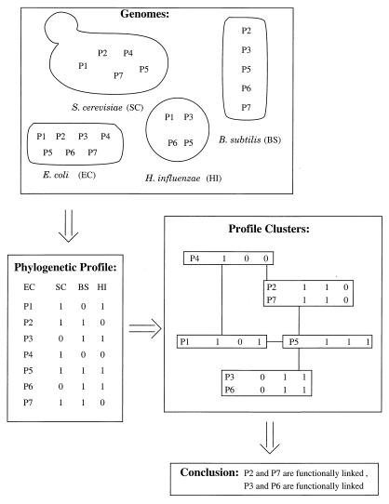
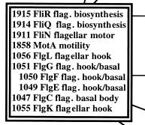
Phylogenetic profiling
Based on homologs
Pellegrini et al, PNAS 1999
Notes:
Which genomes code for homologs. Cluster profiles with same profile, 1bit differences neighbors

Slide 36
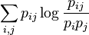
Mutual information
species occurrence
COG1 10011100000111100011
COG2 10010100000111100011
11 = 9/20
1. = 10/20
.1 = 9/20
MI = 0.45 ln (0.45/(0.5*0.45)) = 0.31
species occurrence
COG3 11111111111111111011
COG4 11110111111111111011
11 = 18/20
1. = 19/20
.1 = 18/20
MI = 0.9 ln (0.9/(0.95*0.9)) = 0.05

Slide 37
Gene fusion and phylogenetic profiling based on orthologs
Huynen et al, Genome Research 2000

Slide 38
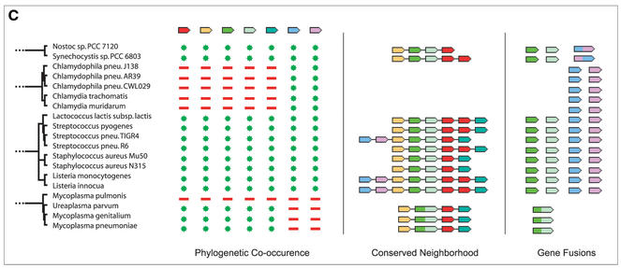
STRING: putting it all together
Von Mering et al, NAR 2003

Slide 39
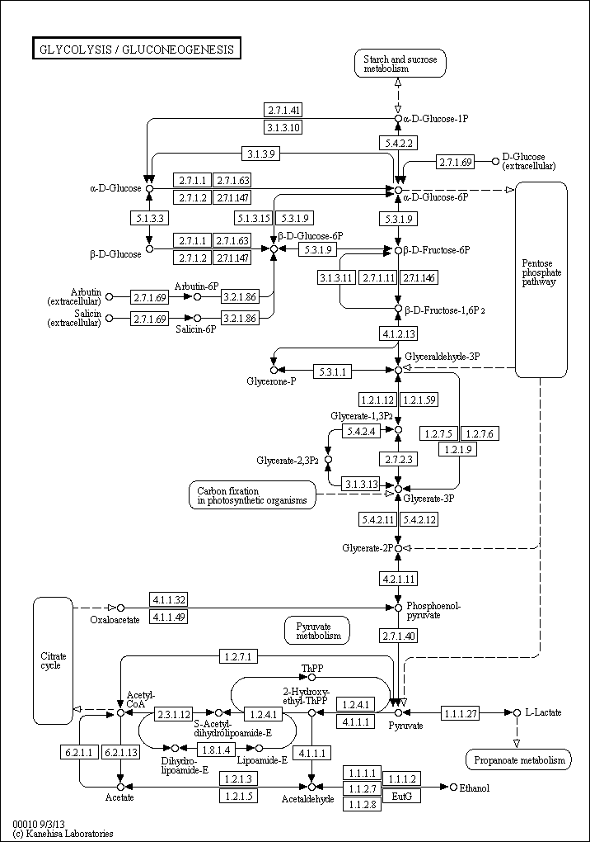
Benchmarking (KEGG pathways)
Same pathway = TP
Different pathway = FP
Fraction = TP/(TP+FP)
Not annotated → not in statistic

Slide 40
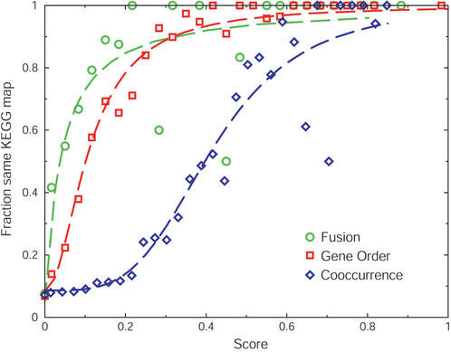
Von Mering et al, NAR 2003
f(x) = a + [(1-a)x^{b}/(c^{b} + x^{b})]
x : the score, a: the intercept, b: the cooperativity, and c: the value of x where half of the maximum is reached
P = 1 – (1 - f1)*(1 - f2) ..
Notes:
Hill function P = 1 – (1-P1)*(1-P2) ..

Slide 41
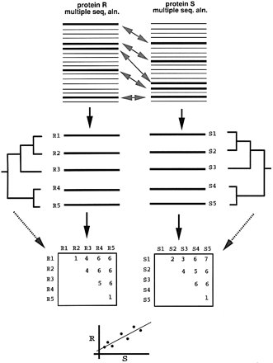
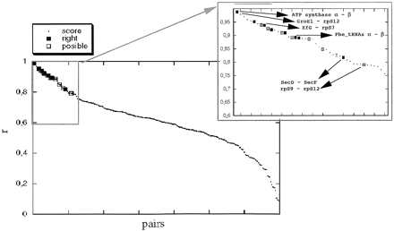
Correlated evolution
Find homologs to E. coli protein
Make alignments
Reduce alignments to overlapping species
Make distance matrices (protdist)
Correlation between the matrices
(No trees!)
Pazos and Valencia, PEDS 2001

Slide 42
Genomic context methods
Conserved gene neighborhood (synteny)
Gene fusions
Co-occurrence
Co-evolution

Slide 43
Comparative genomics in eukaryotes
Gene function annotation

Slide 44
Gene organization in eukaryotes
Promoter
exon
intron
mRNA
5’ UTR
3’ UTR
No operons

Slide 45
Bidirectional promoters
Promoter

Slide 46
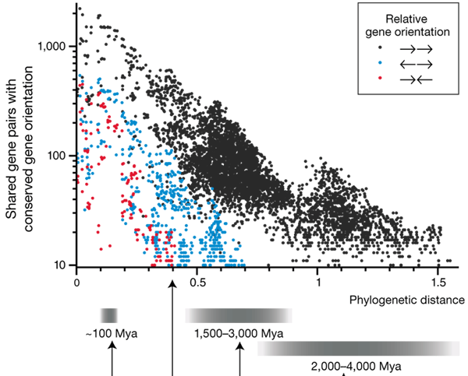
Conservation of gene pairs in bacteria
Korbel et al, Nature Biotechnology 2004

Slide 47
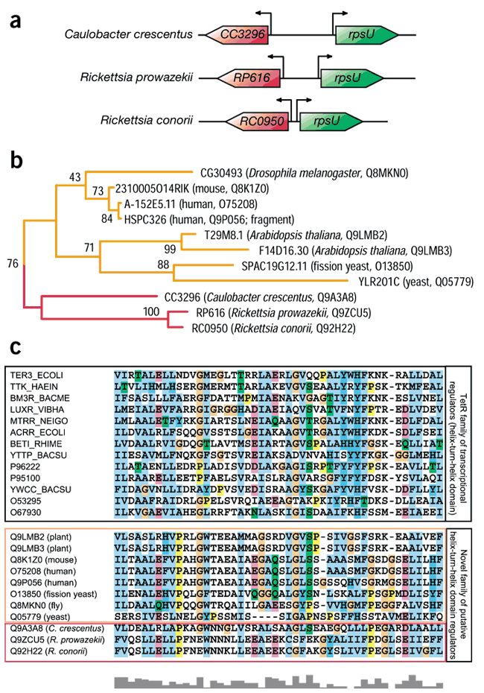
Function prediction by conserved bidirectional pairs
Notes:
The enrichment of genes encoding transcriptional regulators within conserved DT-pairs suggests that novel regulators controlling their adjacent target genes may be discovered. By applying profile-based homology searches, we found evidence for novel regulatory families—for example, we predict that members of the orthologous group 'KOG2969' (obtained from STRING12) form a novel regulatory family involved in regulation of bacterial ribosomal protein S2 (rpsU), as well as its orthologs in eukaryotic mitochondria (see main text). (a) Genes encoding prokaryotic members of KOG2969 (red arrow symbols) are divergently oriented neighbors of rpsU (green arrow symbols). (b) Unrooted phylogenetic tree of KOG2969 constructed using MRBAYES56 (see Supplementary Notes online). (c) CLUSTALW57 sequence alignment of PFAM (protein families) database23 domain 'PF00440' representing the TetR family, and the corresponding homologous region of the members of KOG2969 (amino acid sequences surrounded by colored boxed correspond to eukaryotic members (orange box), or a-proteobacterial members (red box) of KOG2969).

Slide 48
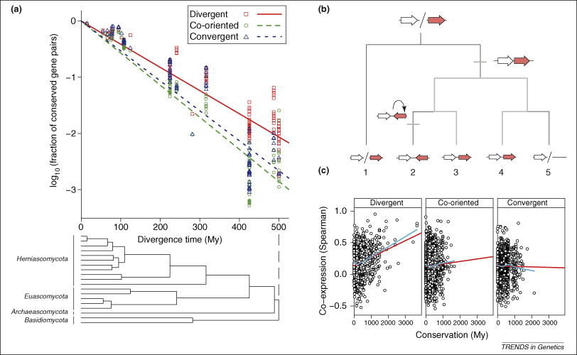
Conservation of divergent gene pairs in fungi
Kensche et al, Trends in Genetics 2008

Slide 49
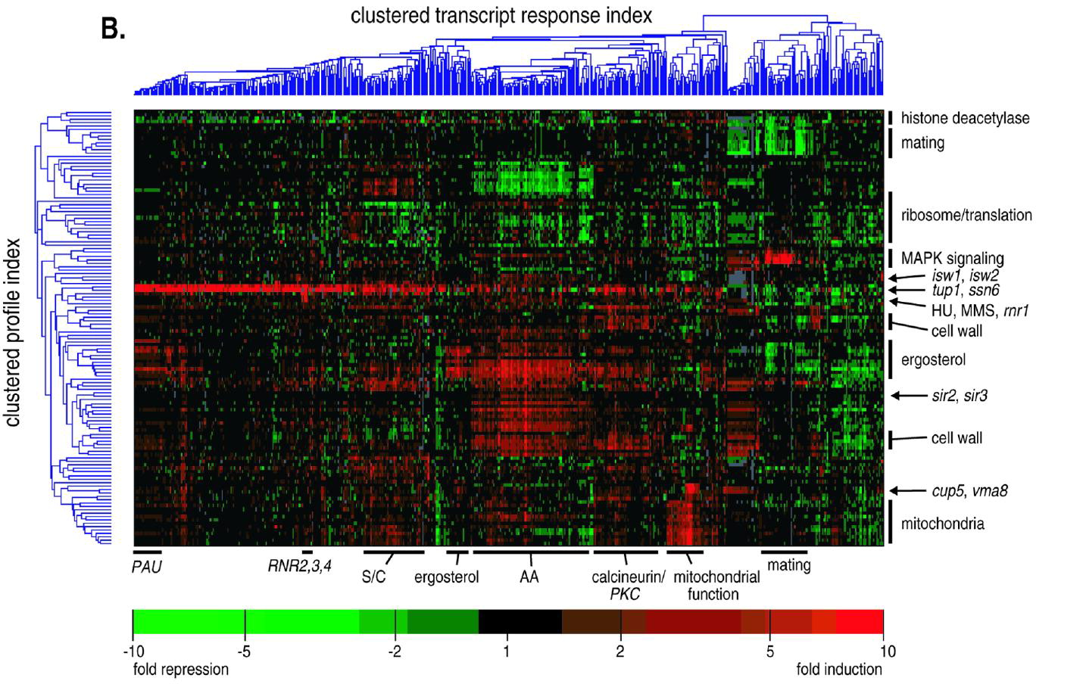
Correlated expression
Hughes et al, Cell 2000

Slide 50
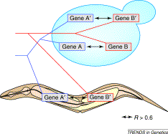
Relations between genes
Pairs of paralogs
Pairs of orthologs
van Noort et al, Trends in genetics 2003

Slide 51
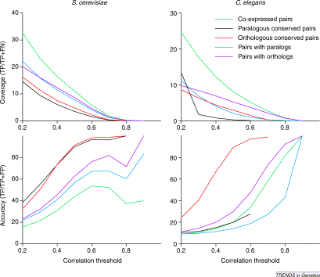
Conserved co-expression for function prediction
van Noort et al, Trends in genetics 2003

Slide 52
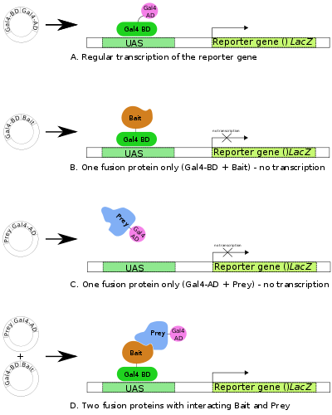
Yeast-2-hybrid interaction data
Gives rise to many
false positive interactions

Slide 53
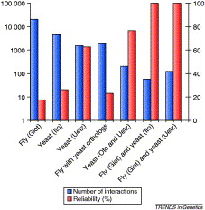
Yeast-2-Hybrid conservation
Reliability:
Percentage of pairs that
occur on the same pathway
Conservation more than just
more data.
Huynen et al, Trends in Genetics 2004

Slide 54
Comparative genomics methods
Conserved bidirectional neighbors
Conserved co-expression
Conserved physical interactions

Slide 55
Assignment
Gene function annotation

Slide 56
Predict the function of FG00500.1
Go to STRING db http://string.embl.de
Enter FG00500.1
Does the protein have any (predicted) interactions?
Can you use them to predict a function?
Enter the orthologous protein name from yeast
Are there any interactions?
In what biological process is this protein involved?

Slide 57
Reading assignment
Read from Literature:
GeneOrder
STRING

